Slide 1

StayExplorer
Stay Explore Discover
Adrian Wong, Asta Remeikiene

Slide 2
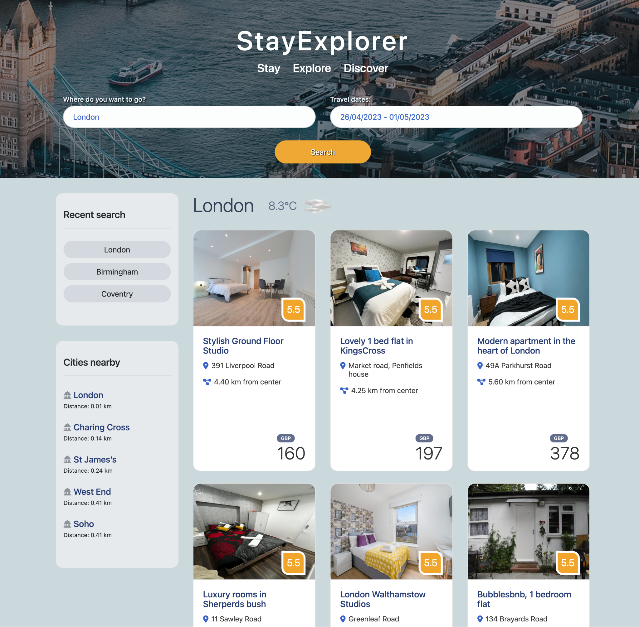
Elevator Pitch
StayExplorer is a user-friendly application designed for travelers.
It provides a well-organized display of hotels in the form of cards, complete with images and brief details. All the user has to do is input the desired destination and travel dates.
The app also offers convenient features like current weather information of the search city, quick access to recent searches, and information about nearby cities.

Slide 3
Concept
Inspiration Our target audience are people who like to explore destination and make discoveries independently. Staying in the hotel would be the starting point for exploring.
That was our inspiration - to create simple app for them to find where to stay and start the adventure.
User Story
Frequent travel is a part of my lifestyle, and as a user, my priority is to have easy access to information about available hotels in my desired destination. I prefer a comprehensive overview of the hotels in the area.
Additionally, it would be helpful to have access to real-time weather updates for my destination and the suggestions for nearby cities that I can explore.

Slide 4
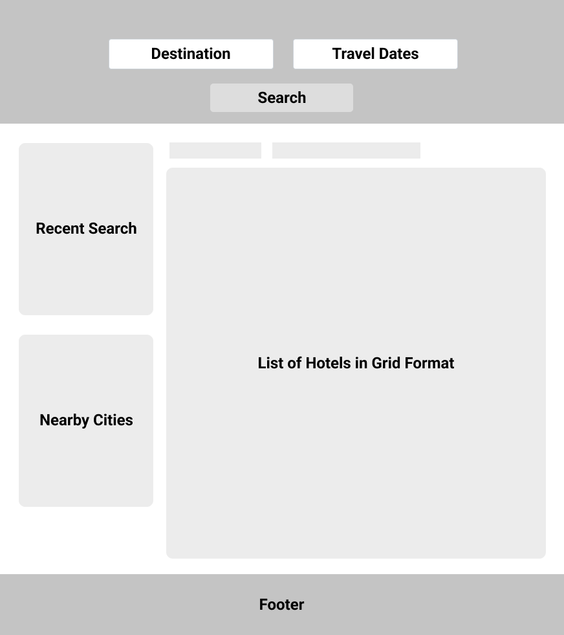
Description
The application is a single-page app that is responsive and compatible with all devices. The user interface consists of a header section for inputting destination and travel dates , and below it, the content is divided into two parts. The left part displays recent searches and nearby cities , while the right part shows hotels in a grid format.
1
2
3
4
5
How to use
To access information on available hotels in the area, users only need to enter their desired destination and travel dates. Detailed information on a particular hotel can be obtained by clicking on the hotel card, which triggers a pop-up modal with comprehensive details.
Users can quickly access previously searched hotels by clicking on the city button in the "Recent Search" section. Additionally, the app suggests nearby cities for users to explore and provides information on their distances from the search city.
1
2
3
5
4

Slide 5
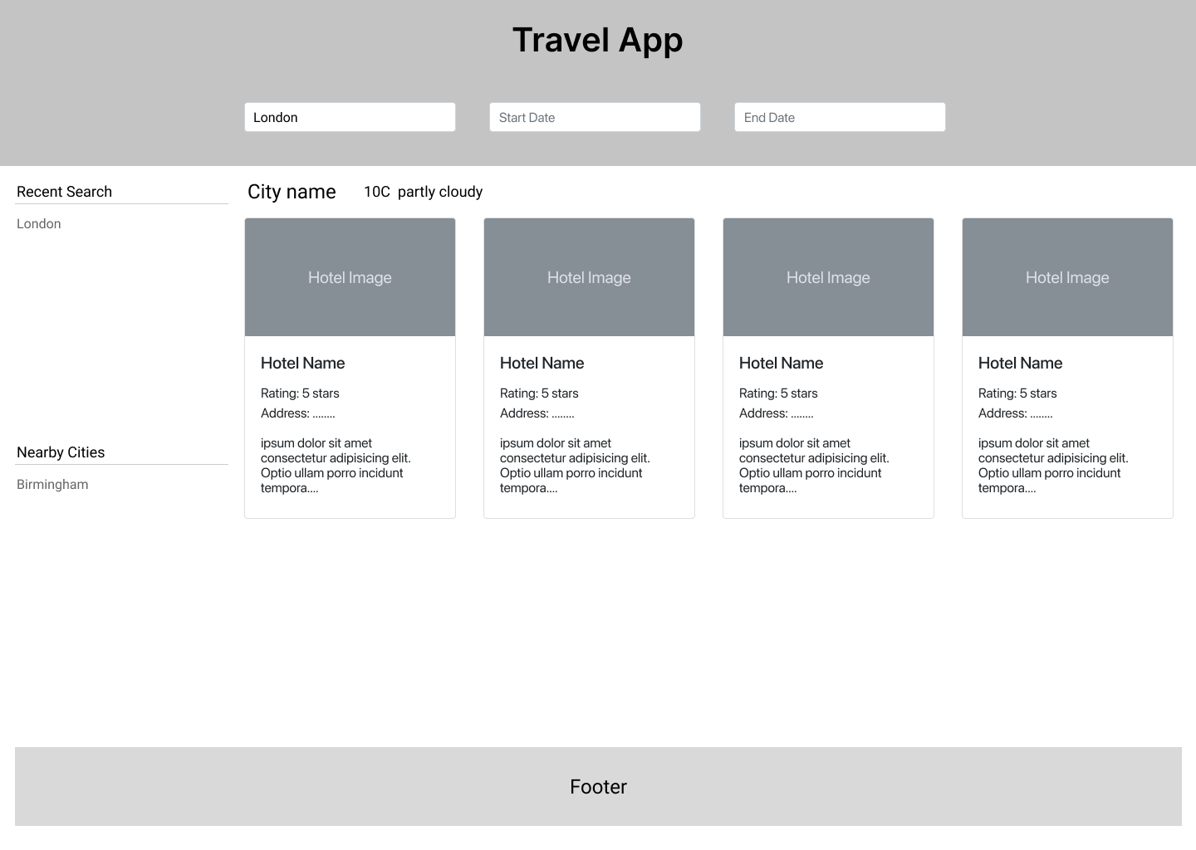
Process
Using Figma to create a wireframe layout
Final product - StayExplorer App
Languages / libraries / API's used
JavaScript
jQuery
Booking API
GeoDB Cities API
AccuWeather API
JavaScript date range picker
Bootstrap
HTML
CSS

Slide 6

Breakdown of Tasks and Roles
Adrian Wong - developing app idea, researching for free API, wireframe and UI design, logic for retrieving the data from APIs and displaying on the page, implementing modal, styling the hotel, recent search and nearby cities sections. Fine tuning the app as well. Making presentation slides.
Asta Remeikiene - developing app idea, researching for free API, building layout structure for the page, researching and implementing image/colors/appearance of the page, writing README.md for the project, making presentation slides.
Diana Purice - developing app idea, researching for free API

Slide 7
Challenges
Free APIs has the quota limit for call request. It is waste time for a developer to register for the new api key frequently.
When dealing with complex APIs, it may be necessary to use multiple endpoints to obtain the desired results. This may require nested Ajax calls at times.
Asynchronous Javascript - how to get information from GeoDB Api, which needs latitude and longitude(it is provided by Booking API)
Need more Javascript knowledge and practise
Coming up with suitable name for application!

Slide 8
Success
The application is able to retrieve data from the all APIs and display it on the screen.
Date range picker and modal is successfully implemented.
Utilizing Bootstrap to design a visually appealing and user-friendly UI.
Collaborate with others to develop the app.

Slide 9
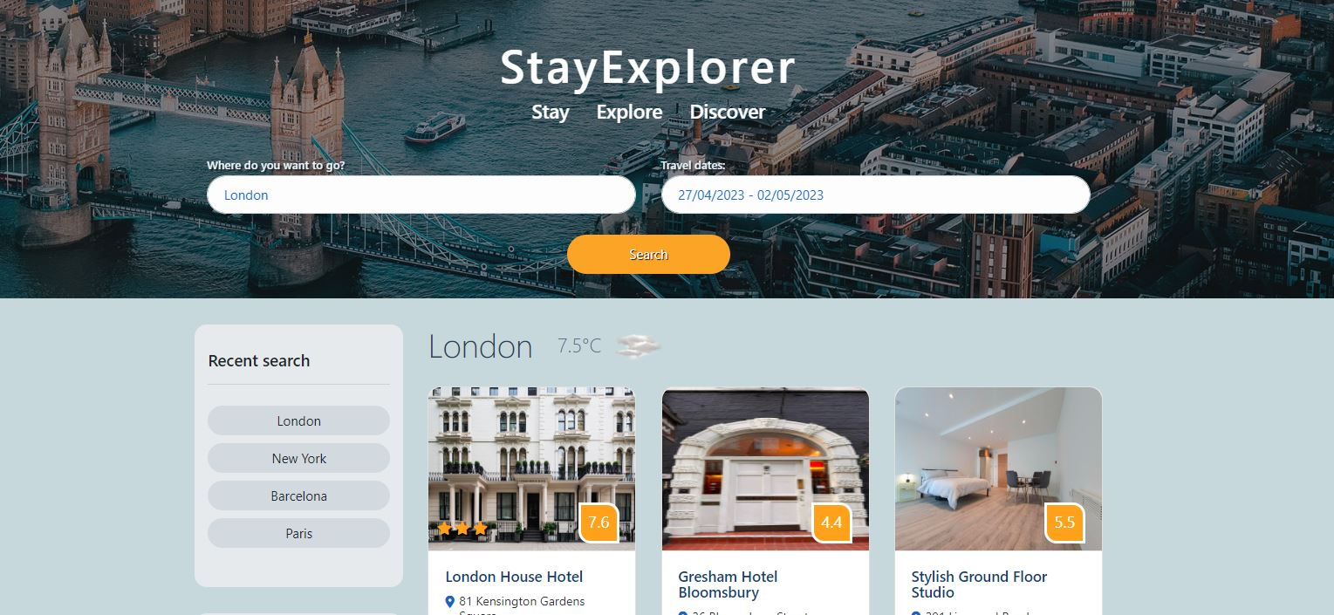
Landing - default location displayed

Slide 10
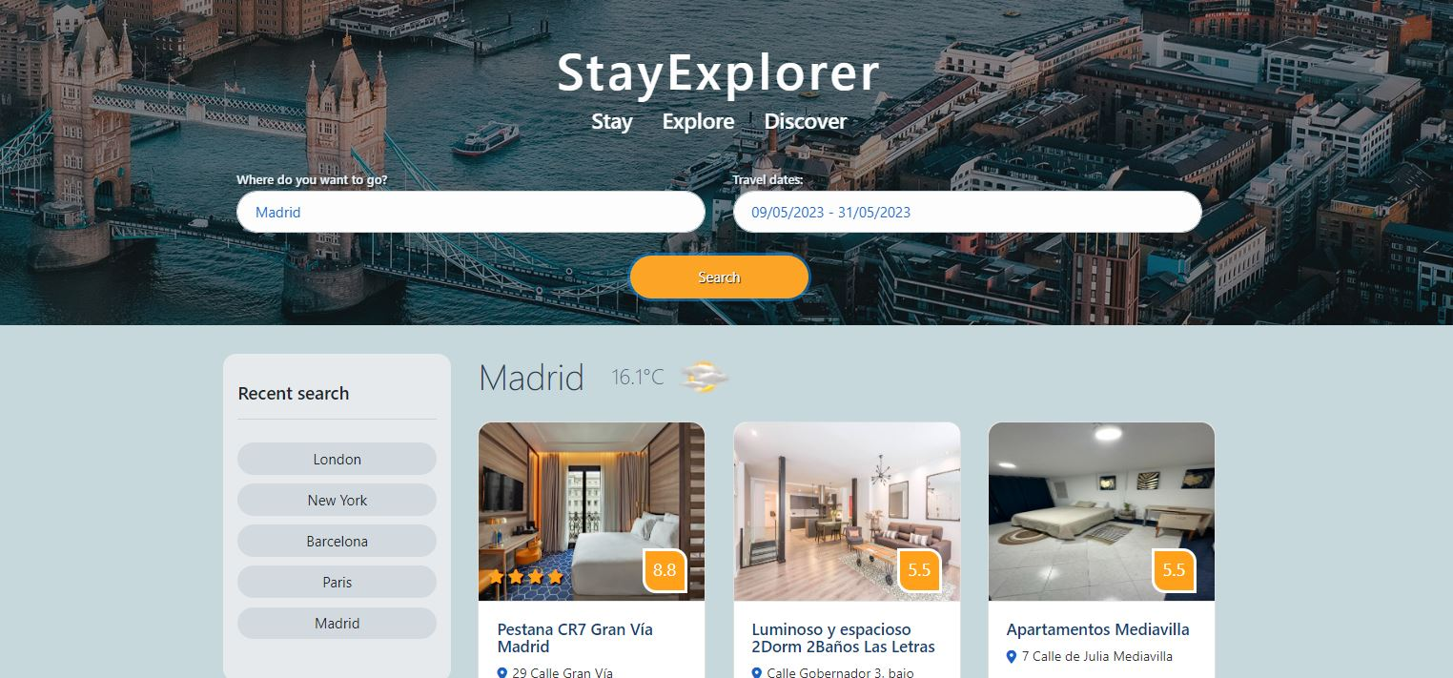
Add desired city name and your travel dates

Slide 11
Directions for Future Development
Display more information about the hotel such as amenities, prices for different types of accommodation.
Add recommended tourist attractions / place of interests.
Add locations on map so that user can easily to estimate how to access the hotel, tourist attractions etc.
Hotel booking.
More weather information for destination such as weather forecast.
For security, make the API keys are not visible to public

Slide 12
Links
Deployed - https://astarem.github.io/travel-app/
GitHub repo - https://github.com/AstaRem/travel-app

Slide 13
Thank you for participating!

